Slide 1
Introduction to Discrete Probability
Section 7.1

Slide 2
Video 73: Probability
Finite probability
Examples

Slide 3
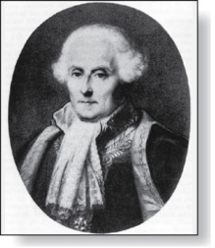

Probability of an Event
Pierre-Simon Laplace
(1749-1827)
Pierre-Simon Laplace’s classical theory of probability was introduced in the 18th century, when he analyzed games of chance.
Definitions:
An experiment is a procedure that yields one of a given set of possible outcomes: rolling the dice
The sample space S of the experiment is the set of possible outcomes: faces of the dice S = {1,2,3,4,5,6}
An event E is a subset of the sample space: e.g., E = {5,6}
An event occurs, if the outcome belongs to the sample space: E occurs when rolling a 6

Slide 4
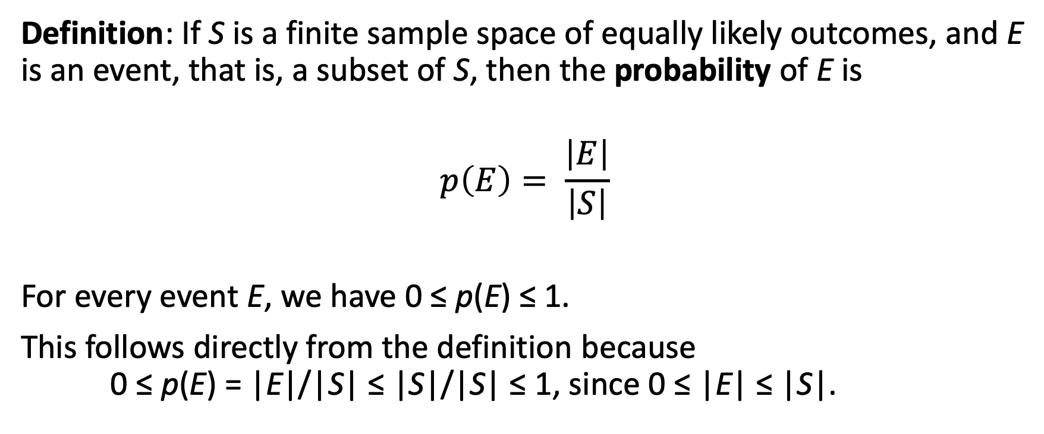
Probability of an Event
Definition: If S is a finite sample space of equally likely outcomes, and E is an event, that is, a subset of S, then the probability of E is
$$p\left(E\right)= \frac{\left|E\right|}{\left|S\right|}$$
For every event E, we have 0 ≤ p(E) ≤ 1.
This follows directly from the definition because 0 ≤ p(E) = |E|/|S| ≤ |S|/|S| ≤ 1, since 0 ≤ |E| ≤ |S|.

Slide 5
Example
What is the probability that when two dice are rolled, the sum of the numbers on the two dice is 7?
By the product rule there are 6² = 36 possible outcomes
6 of these sum up to 7: 1+6, 2+5, 3+4, 4+3, 5+2, 6+1
Hence, the probability of obtaining a 7 is 6/36 = 1/6

Slide 6
Example
There are many lotteries that award prizes to people who correctly choose a set of six numbers out of the first n positive integers, where n is usually between 30 and 60.
What is the probability that a person picks the correct six numbers out of 40?
The number of ways to choose six numbers out of 40 is
C(40,6) = 40!/(34!6!) = 3,838,380.
Hence, the probability of picking a winning combination is 1/3,838,380 ≈ 0.00000026.

Slide 7
Example
What is the probability that the numbers 11, 4, 17, 39, and 23 are drawn in that order from a bin with 50 balls labeled with the numbers 1,2, …, 50 if
The ball selected is not returned to the bin.
The ball selected is returned to the bin before the next ball is selected.
Use the product rule in each case.
Sampling without replacement: The probability is 1/254,251,200 since there are 50 ∙ 49 ∙ 48 ∙ 47 ∙ 46 = 254,251,200 ways to choose the five balls.
Sampling with replacement: The probability is 1/50⁵ = 1/312,500,000 since 50⁵ = 312,500,000.

Slide 8
Summary
Finite probability
Sample Space, Event, Probability
Examples
Card Games, Lotteries

Slide 9
Video 74: Complements and Unions of Events
Complements
Unions
Examples

Slide 10
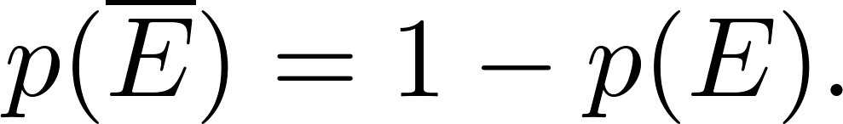
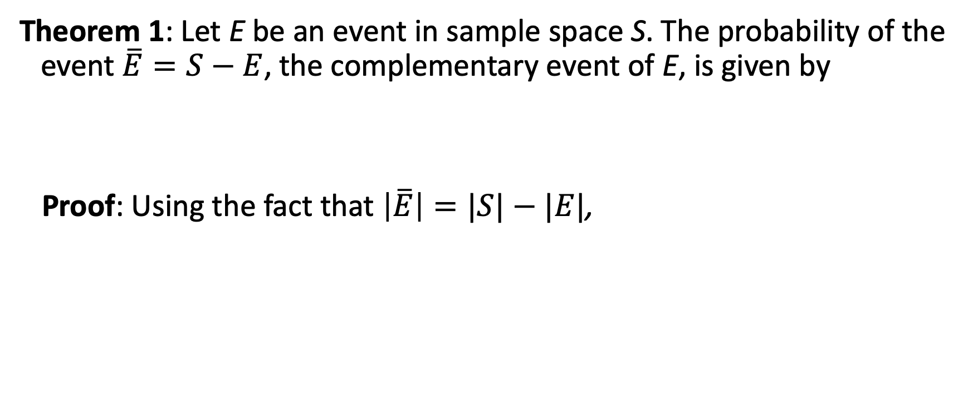
The Probability of Complements of Events
Theorem 1: Let E be an event in sample space S. The probability of the event $\overline{E}=S−E$, the complementary event of E, is given by
Proof: Using the fact that $\left|\overline{E}\right|=|S|−|E|$,

Slide 11
Example
What is the probability that when two dice are rolled, the sum of the numbers on the two dice is not 7?
Let E be the event to roll a 7.
This probability is 1/6.
Thus the probability of not rolling a 7 is 1 – 1/6 = 5/6

Slide 12
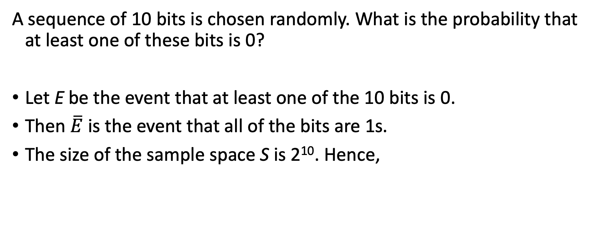
Example
A sequence of 10 bits is chosen randomly. What is the probability that at least one of these bits is 0?
Let E be the event that at least one of the 10 bits is 0.
Then $\overline{E}$ is the event that all of the bits are 1s.
The size of the sample space S is 2¹⁰. Hence,

Slide 13
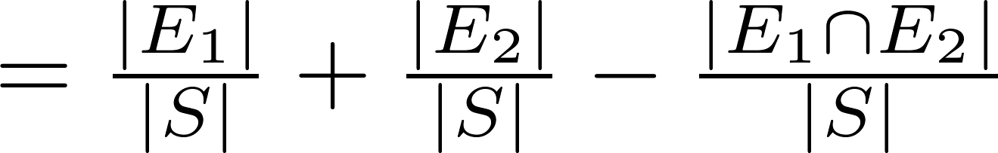
The Probability of Unions of Events
Theorem 2: Let E₁ and E₂ be events in the sample space S. Then
Proof: Given the inclusion-exclusion formula |A ∪ B| = |A| + | B| − |A ∩ B|, it follows that

Slide 14
Example
What is the probability that a positive integer selected at random from the set of positive integers not exceeding 100 is divisible by either 2 or 5?
Let E₁ be the event that the integer is divisible by 2 and E₂ be the event that it is divisible 5.
Then the event that the integer is divisible by 2 or 5 is E₁ ∪ E₂
The event that the integer is divisible by 2 and 5 is E₁ ∩ E₂
It follows that:
p(E₁ ∪ E₂) = p(E₁) + p(E₂) – p(E₁ ∩ E₂)
= 50/100 + 20/100 − 10/100 = 3/5.

Slide 15
Example
When rolling two dices, what is the probability to roll a 6?
Let E₁ be the event that the first dice is a 6 and E₂ be the event that the second dice is a 6.
Then the event that one dice is a 6 is E₁ ∪ E₂
The event that both dices are a 6 is E₁ ∩ E₂
It follows that:
p(E₁ ∪ E₂) = p(E₁) + p(E₂) – p(E₁ ∩ E₂) = 1/6 + 1/6 – 1/36 = 11/36

Slide 16
Summary
Complements
Unions
Examples

Slide 17
Probability Theory
Section 7.2

Slide 18
Video 75: Probability Distributions
Limitations of Laplace’s Probability
Probability Distribution
Laws on Probability Distributions

Slide 19
Limitation of Laplace’s Definition
Laplace’s definition from the previous section, assumes that all outcomes are equally likely. This is not always the case.
Example: The sum of rolling two dices.
Set of possible outcomes: S = {2,3,4,5,6,7,8,9,10,11,12}
Probability of sum 2: need to roll (1,1), thus 1/36
Probability of sum 3: need to roll (1,2) or (2,1), thus 1/18
Probability of sum 4: need to roll (1,3), (2,2) or (3,1), thus 1/12

Slide 20
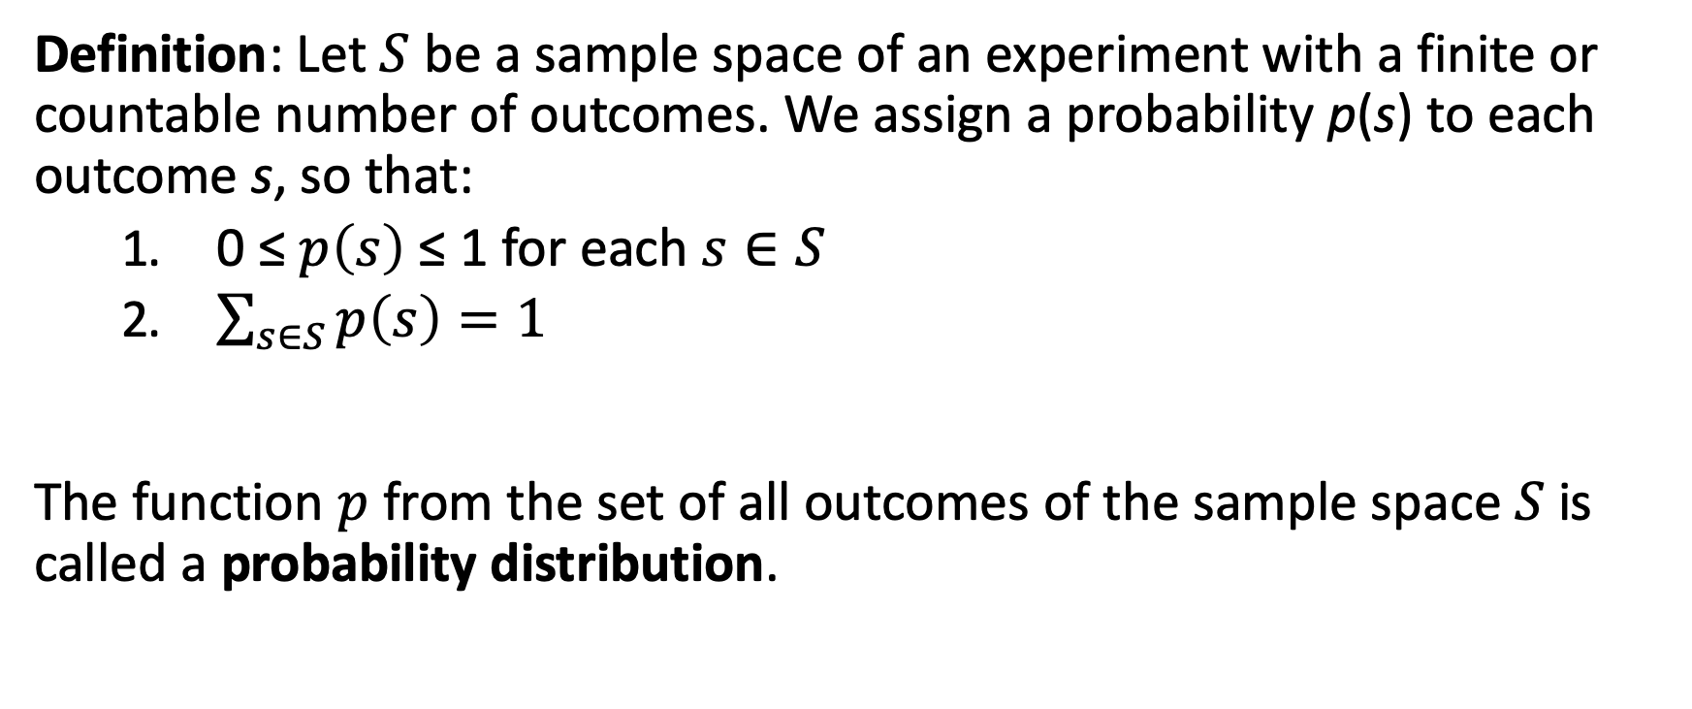
Probability Distribution
Definition: Let $S$ be a sample space of an experiment with a finite or countable number of outcomes. We assign a probability p(s) to each outcome s, so that:
0 ≤ $p\left(s\right)$ ≤ 1 for each $s∈S$
$\sum_{s∈S}{p\left(s\right)=1}$
The function $p$ from the set of all outcomes of the sample space $S$ is called a probability distribution.

Slide 21
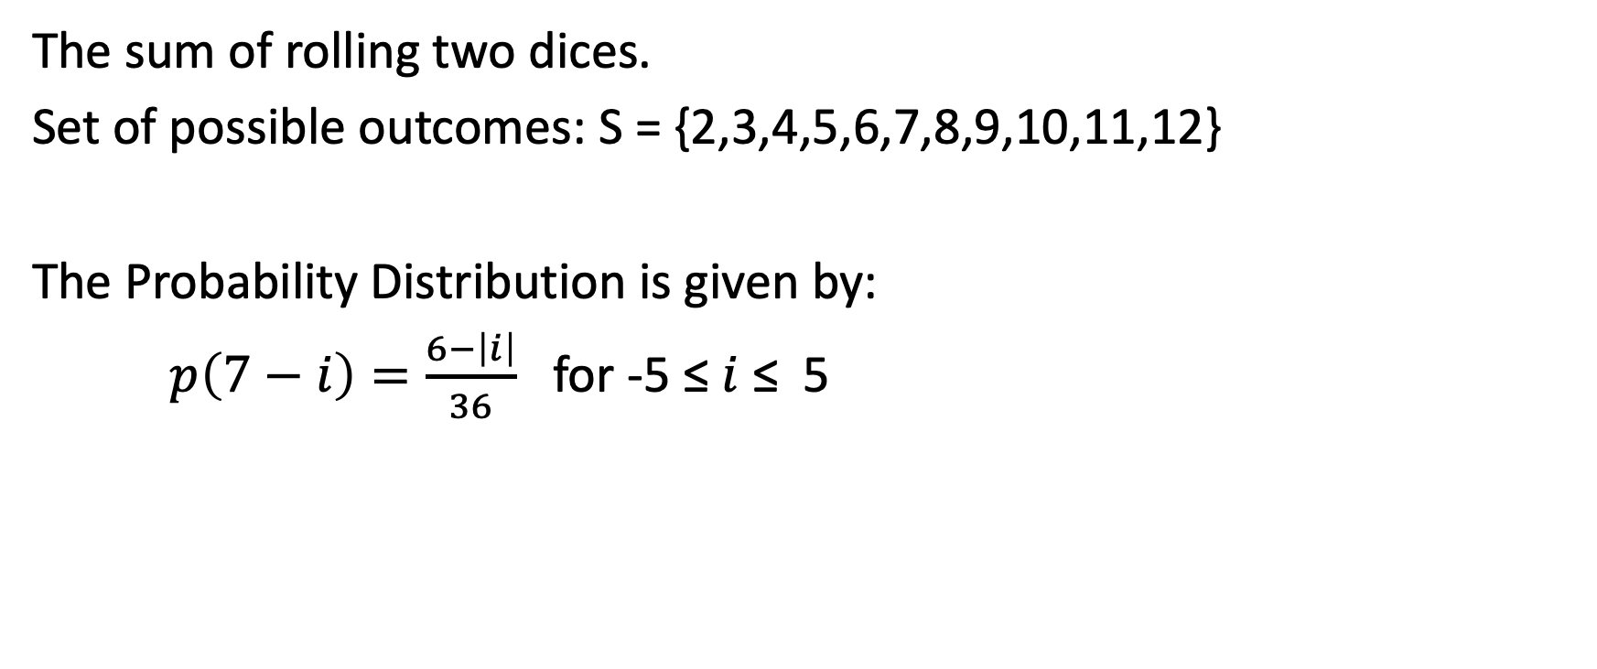
Example
The sum of rolling two dices.
Set of possible outcomes: S = {2,3,4,5,6,7,8,9,10,11,12}
The Probability Distribution is given by:
$p\left(7−i\right)=\frac{6−\left|i\right|}{36}$ for -5 ≤ $i$ ≤ 5

Slide 22
Example
What probabilities should we assign to the outcomes H(heads) and T (tails) when the coin is biased so that heads come up twice as often as tails?
For a biased coin, we have p(H) = 2p(T).
Because p(H) + p(T) = 1, it follows that 2p(T) + p(T) = 3p(T) = 1.
Hence, p(T) = 1/3 and p(H) = 2/3.

Slide 23
Uniform Distribution
Definition: Suppose that S is a set with n elements. The uniform distribution assigns the probability 1/n to each element of S.
Example: Consider again the coin flipping example, but with a fair coin.
Then p(H) = p(T) = 1/2.

Slide 24
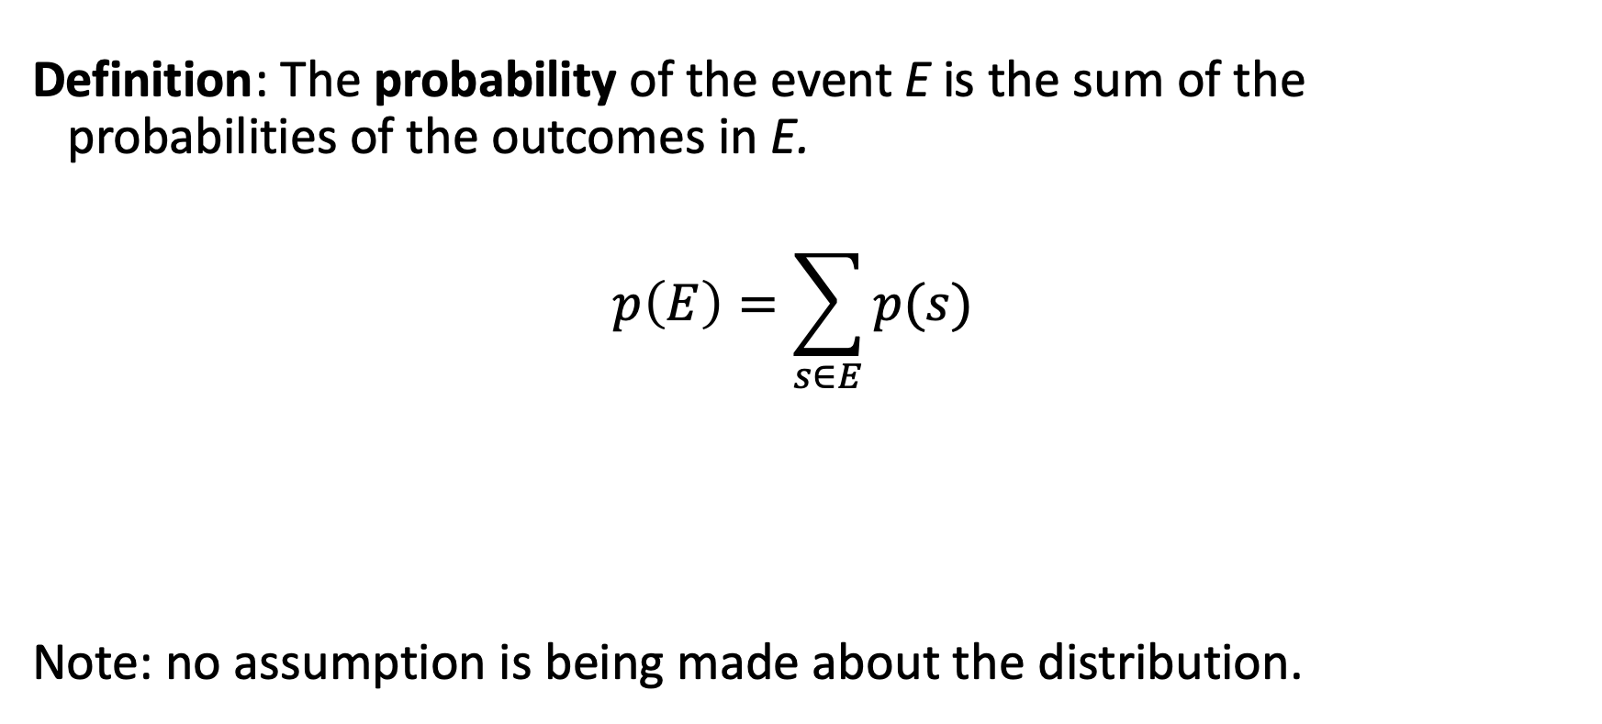
Probability of an Event
Definition: The probability of the event E is the sum of the probabilities of the outcomes in E.
$$p\left(E\right)=\sum_{s∈E}{p(s)}$$
Note: no assumption is being made about the distribution.

Slide 25
Example
Suppose that a dice is biased so that 3 appears twice as often as each other number, but that the other five outcomes are equally likely.
What is the probability that an odd number appears when we roll this die?
We want the probability of the event E = {1,3,5}.
We have p(3) = 2/7 and p(1) = p(2) = p(4) = p(5) = p(6) = 1/7
Hence, p(E) = p(1) + p(3) + p(5) = 1/7 + 2/7 + 1/7 = 4/7

Slide 26
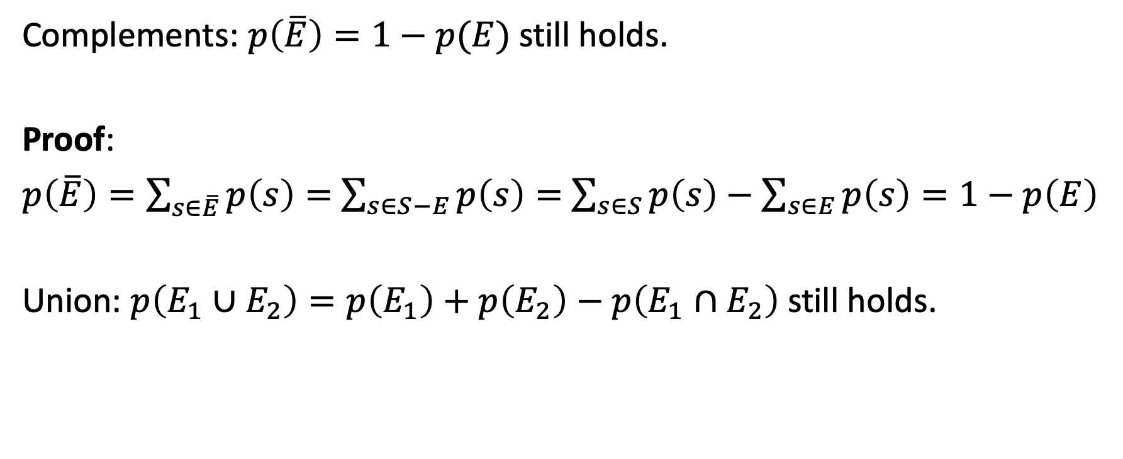
Probabilities of Complements and Unions
Complements: $p\left(\overline{E}\right)=1−p(E)$ still holds.
Proof:
$p\left(\overline{E}\right)=\sum_{s∈\overline{E}}{p\left(s\right)}=$ $\sum_{s∈S−E}{p\left(s\right)}=$ $\sum_{s∈S}{p\left(s\right)}−\sum_{s∈E}{p\left(s\right)=1−p\left(E\right)}$
Union: $p\left(E_{1}∪E_{2}\right)=p\left(E_{1}\right)+p\left(E_{2}\right)−p\left(E_{1}∩E_{2}\right)$ still holds.

Slide 27
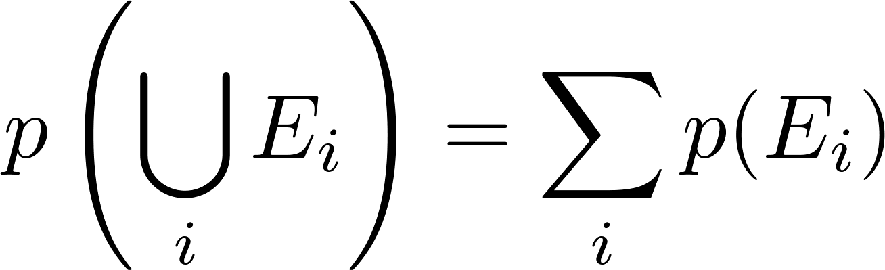
Combinations of Events
Theorem 3: If E₁, E₂, … is a sequence of pairwise disjoint events in a sample space S, then

Slide 28
Summary
Limitations of Laplace’s Probability
Probability Distribution
Uniform distribution
Probability of events
Laws on Probability Distributions
Complement and Union
Disjoint events

Slide 29
Video 76: Conditional Probability
Conditional Probability
Independence

Slide 30
Conditional Probability
Often probabilities exist in some context, or when a certain condition is satisfied:
what’s chance to test positive on Corona?
what’s chance to test positive on Corona if I feel sick?
what’s the chance of having heads if the last 5 tosses were tails?
Generally speaking: intuition cannot be trusted

Slide 31
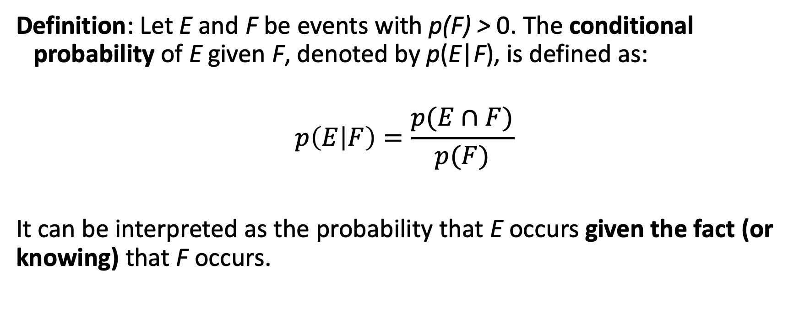
Conditional Probability
Definition: Let E and F be events with p(F) > 0. The conditional probability of E given F, denoted by p(E|F), is defined as:
$$p\left(E | F\right)=\frac{p(E∩F)}{p(F)}$$
It can be interpreted as the probability that E occurs given the fact (or knowing) that F occurs.

Slide 32
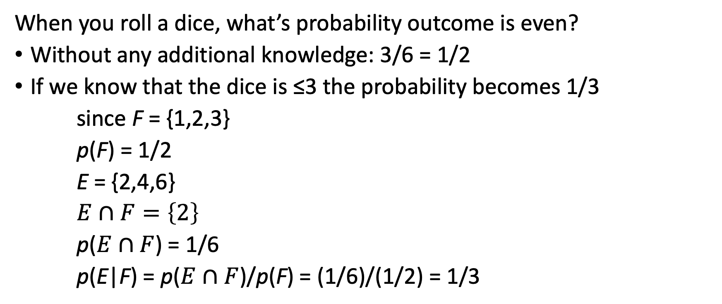
Example
When you roll a dice, what’s probability outcome is even?
Without any additional knowledge: 3/6 = 1/2
If we know that the dice is ≤3 the probability becomes 1/3
since F = {1,2,3}
p(F) = 1/2
E = {2,4,6}
$E∩F=\left\{2\right\}$
p($E∩F$) = 1/6
p(E|F) = p($E∩F$)/p(F) = (1/6)/(1/2) = 1/3

Slide 33
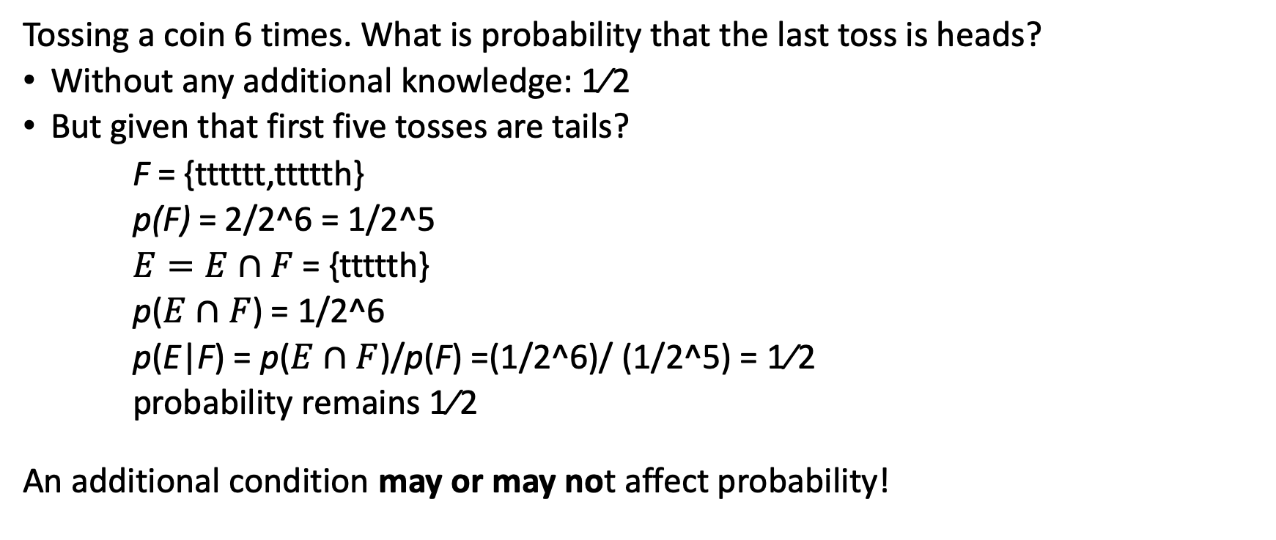
Example
Tossing a coin 6 times. What is probability that the last toss is heads?
Without any additional knowledge: 1⁄2
But given that first five tosses are tails?
F = {tttttt,ttttth}
p(F) = 2/2^6 = 1/2^5
$E=E∩F$= {ttttth}
p($E∩F$) = 1/2^6
p(E|F) = p($E∩F$)/p(F) =(1/2^6)/ (1/2^5) = 1⁄2
probability remains 1⁄2
An additional condition may or may not affect probability!

Slide 34
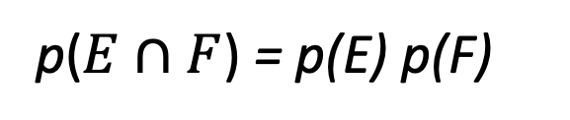
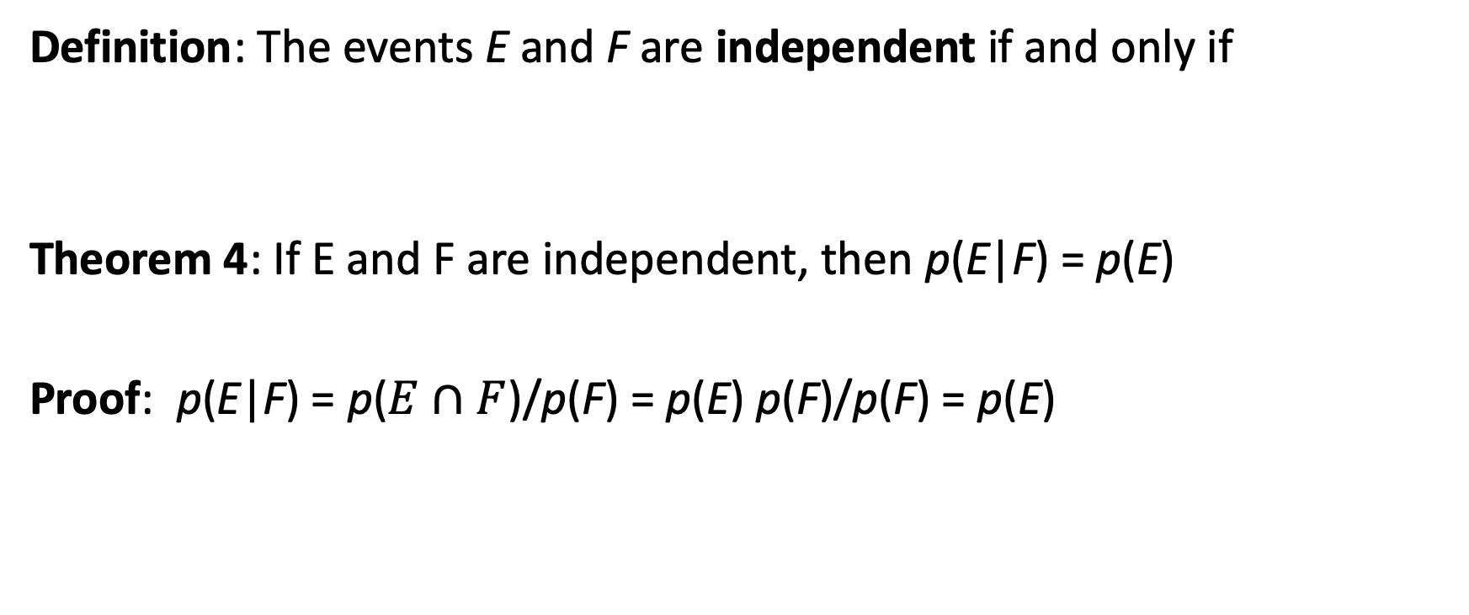
Independence
Definition: The events E and F are independent if and only if
Theorem 4: If E and F are independent, then p(E|F) = p(E)
Proof: p(E|F) = p($E∩F$)/p(F) = p(E) p(F)/p(F) = p(E)
p($E∩F$) = p(E) p(F)

Slide 35
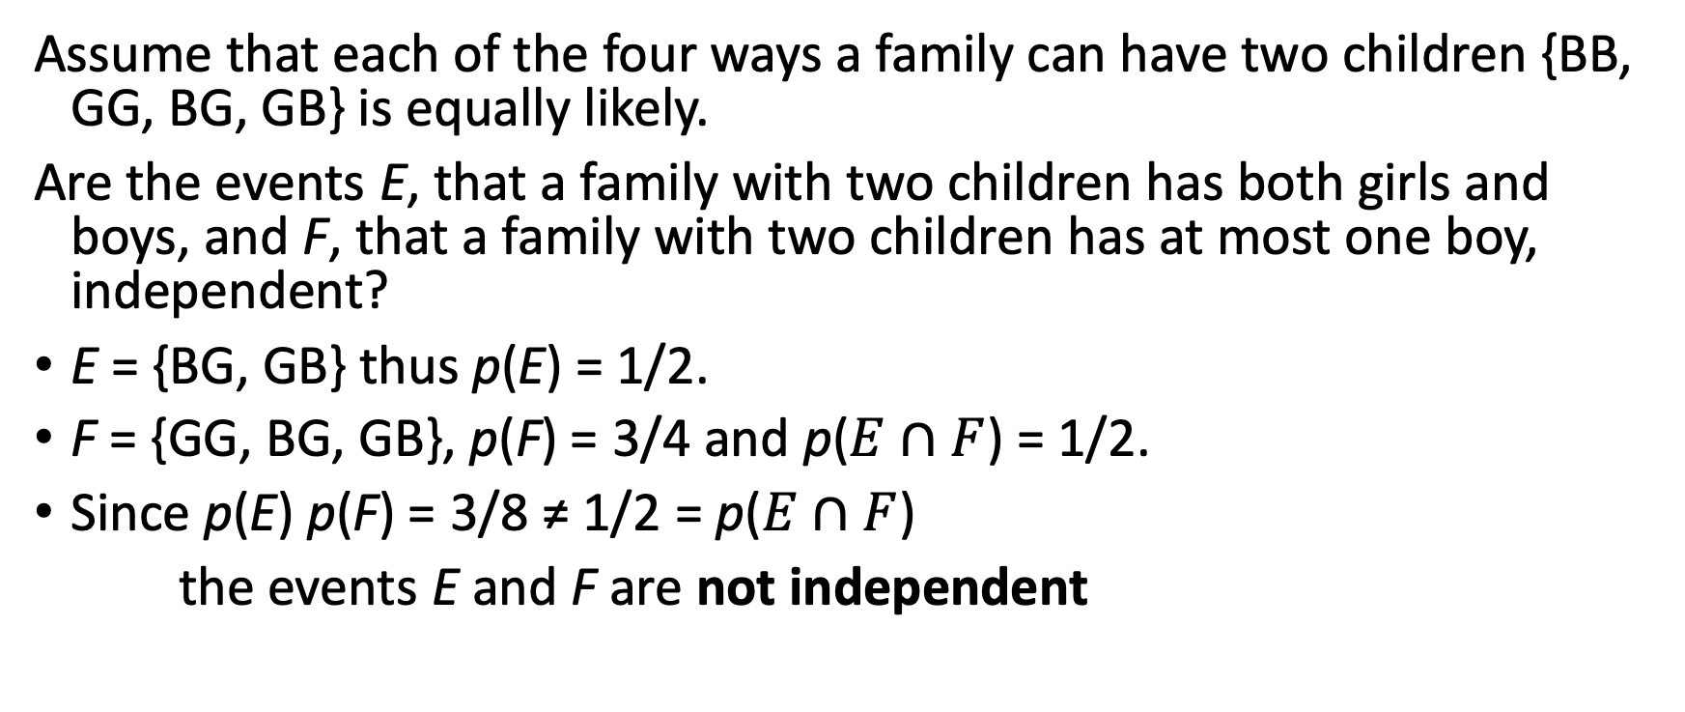
Example
Assume that each of the four ways a family can have two children {BB, GG, BG, GB} is equally likely.
Are the events E, that a family with two children has both girls and boys, and F, that a family with two children has at most one boy, independent?
E = {BG, GB} thus p(E) = 1/2.
F = {GG, BG, GB}, p(F) = 3/4 and p($E∩F$) = 1/2.
Since p(E) p(F) = 3/8 ≠ 1/2 = p($E∩F$)
the events E and F are not independent

Slide 36
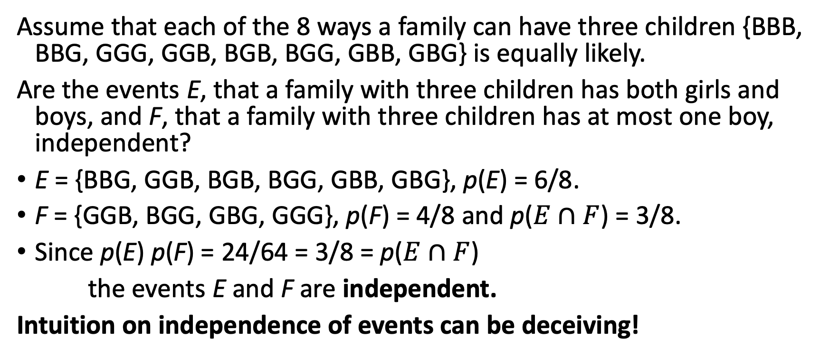
Example
Assume that each of the 8 ways a family can have three children {BBB, BBG, GGG, GGB, BGB, BGG, GBB, GBG} is equally likely.
Are the events E, that a family with three children has both girls and boys, and F, that a family with three children has at most one boy, independent?
E = {BBG, GGB, BGB, BGG, GBB, GBG}, p(E) = 6/8.
F = {GGB, BGG, GBG, GGG}, p(F) = 4/8 and p($E∩F$) = 3/8.
Since p(E) p(F) = 24/64 = 3/8 = p($E∩F$)
the events E and F are independent.
Intuition on independence of events can be deceiving!

Slide 37
Pairwise and Mutual Independence
Definition: The events E₁, E₂, …, E_{n} are pairwise independent if and only if p(E_{i} ⋂ E_{j}) = p(E_{i}) p(E_{j}) for all pairs i and j with i ≤ j ≤ n.
The events are mutually independent if
whenever i_{j}, j = 1,2,…., m, are integers with
1 ≤ i₁ < i₂ <∙∙∙ < i_{m} ≤ n and m ≥ 2.
Mutual Independence implies pairwise independence

Slide 38
Example
Toss a fair coin twice.
E₁ = first toss is 1, p(E₁) = ½
E₂ = second toss is 1, p(E₂) = ½
E₃ = the two outcomes are different, p(E₃) = ½
E₁, E₂, E₃ are pairwise independent, e.g. p(E₁ ⋂ E₃) = ¼ = p(E₁) p(E₃)
But p(E₁ ⋂ E₂ ⋂ E₃) = 0 ≠ p(E₁) p(E₂) p(E₃) = 1/8
Pairwise independence does not imply mutual independence!

Slide 39
Summary
Conditional Probability
Independence
Independence of two events
Independence of multiple events

Slide 40
Video 77: Bernoulli Trials
Bernoulli trials
Binomial distribution

Slide 41
Example
A coin is biased so that the probability of heads is 2/3.
What is the probability that exactly four heads occur when the coin is flipped seven times?
There are 2⁷ = 128 possible outcomes.
The number of ways four of the seven flips can be heads is C(7, 4).
The probability of each of the outcomes is (2/3)⁴ (1/3)³ since the seven flips are independent.
Hence, the probability that exactly four heads occur is
C(7,4) (2/3)⁴ (1/3)³ = (35∙ 16)/2⁷ = 560/2187

Slide 42
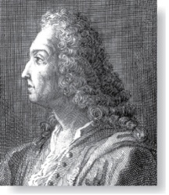
Bernoulli Trials
James Bernoulli
(1854 – 1705)
Definition: Given an experiment that can have only two possible outcomes.
Each performance of the experiment is called a Bernoulli trial.
One outcome is called a success and the other a failure.
If p is the probability of success and q the probability of failure, then p + q = 1.
Frequent question: determine the probability of k successes when an experiment consists of n mutually independent Bernoulli trials.

Slide 43
Independent Bernoulli Trials
Theorem 5: The probability of exactly k successes in n independent Bernoulli trials, with probability of success p and probability of failure q = 1 − p, is
C(n,k) p^{k} q^{n−k}.
Proof: The outcome of n Bernoulli trials is an n-tuple (t₁,t₂,…,t_{n}), where each is t_{i} either S (success) or F (failure).
The probability of each outcome of n trials consisting of k successes and n - k failures (in any order) is p^{k} q^{n−k}.
Because there are C(n,k) n-tuples of Ss and Fs that contain exactly k Ss, the probability of k successes is C(n,k) p^{k} q^{n−k}.

Slide 44
Binomial Distribution
We denote by b(k:n, p) the probability of k successes in n independent Bernoulli trials with p the probability of success.
Viewed as a function of k, b(k:n,p) is the binomial distribution.
By the previous Theorem 5,
b(k:n, p) = C(n,k) p^{k} q^{n−k}.

Slide 45
Summary
Bernoulli trials
Binomial distribution

Slide 46
Bayes’ Theorem
Section 7.3

Slide 47
Video 78: Bayes’ Theorem
Bayes’ Theorem
Generalized Bayes’ Theorem

Slide 48
Motivation for Bayes’ Theorem
Bayes’ theorem allows us to use probability to answer questions such as the following:
Given that someone tests positive for having Corona, what is the probability that they actually do have Corona?
Given that someone tests negative for Corona, what is the probability, that in fact they do have Corona?
Bayes’ theorem has applications to medicine, law, artificial intelligence, engineering, and many diverse other areas.

Slide 49
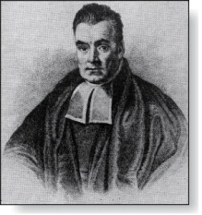
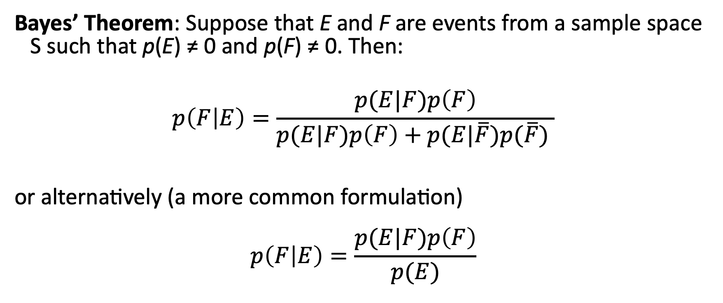
Bayes’ Theorem
Thomas Bayes
(1702-1761)
Bayes’ Theorem: Suppose that E and F are events from a sample space S such that p(E) ≠ 0 and p(F) ≠ 0. Then:
$$p\left(F | E\right)=\frac{p(E|F)p\left(F\right)}{p(E|F)p\left(F\right)+p(E|\overline{F})p(\overline{F}) }$$
or alternatively (a more common formulation) $$p\left(F | E\right)=\frac{p(E|F)p\left(F\right)}{p(E)}$$

Slide 50
Example
We have two boxes. The first box contains two green balls and seven red balls. The second contains four green balls and three red balls.
Bob selects one of the boxes at random.
Then he selects a ball from that box at random.
If he has a red ball, what is the probability that he selected a ball from the first box?
1
2

Slide 51
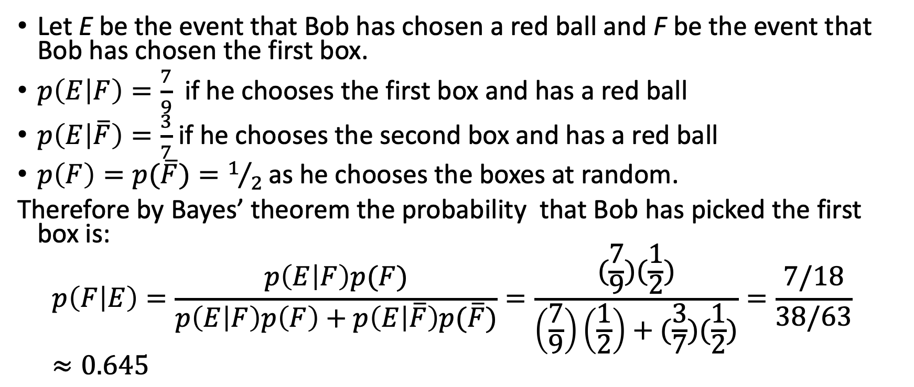
Example
1
2
Let E be the event that Bob has chosen a red ball and F be the event that Bob has chosen the first box.
$p\left(E | F\right)=\frac{7}{9}$if he chooses the first box and has a red ball
$p\left(E | \overline{F}\right)=\frac{3}{7}$ if he chooses the second box and has a red ball
$p\left(F\right)=p(\overline{F})=1/2$as he chooses the boxes at random.
Therefore by Bayes’ theorem the probability that Bob has picked the first box is:
$$p\left(F | E\right)=\frac{p\left(E | F\right)p(F)}{p\left(E | F\right)p\left(F\right)+p\left(E | \overline{F}\right)p(\overline{F})}=\frac{(\frac{7}{9})(\frac{1}{2})}{\left(\frac{7}{9}\right)\left(\frac{1}{2}\right)+(\frac{3}{7})(\frac{1}{2})}=\frac{7/18}{38/63}≈0.645$$

Slide 52
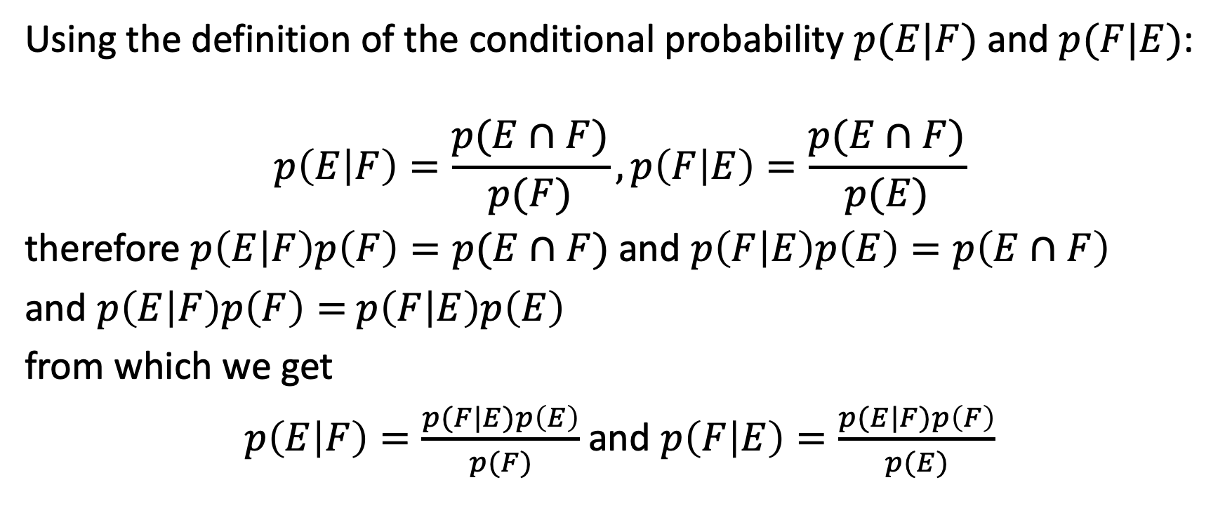
Derivation of Bayes’ Theorem
Using the definition of the conditional probability $p(E|F)$and $p(F|E)$:
$$p\left(E | F\right)=\frac{p(E∩F)}{p(F)},p\left(F | E\right)=\frac{p(E∩F)}{p(E)}$$
therefore $p\left(E | F\right)p\left(F\right)=p(E∩F)$ and $p\left(F | E\right)p\left(E\right)=p\left(E∩F\right)$
and $p\left(E | F\right)p\left(F\right)=$ $p\left(F | E\right)p\left(E\right)$
from which we get
$p\left(E | F\right)=\frac{p(F|E)p\left(E\right)}{p(F)}$ and $p\left(F | E\right)=\frac{p(E|F)p\left(F\right)}{p(E)}$

Slide 53
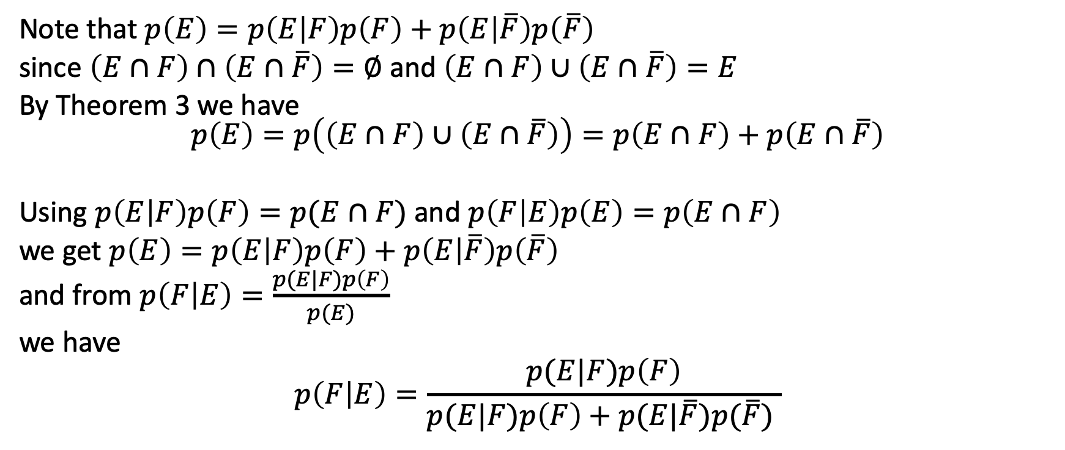
Derivation of Bayes’ Theorem
Note that $p\left(E\right)=p\left(E | F\right)p\left(F\right)+p\left(E | \overline{F}\right)p\left(\overline{F}\right)$
since $\left(E∩F\right)∩\left(E∩\overline{F}\right)=∅$ and $\left(E∩F\right)∪\left(E∩\overline{F}\right)=E$
By Theorem 3 we have $$p\left(E\right)=p\left(\left(E∩F\right)∪\left(E∩\overline{F}\right)\right)=p\left(E∩F\right)+p\left(E∩\overline{F}\right)$$
Using $p\left(E | F\right)p\left(F\right)=p(E∩F)$ and $p\left(F | E\right)p\left(E\right)=p\left(E∩F\right)$
we get $p\left(E\right)=p\left(E | F\right)p\left(F\right)+p\left(E | \overline{F}\right)p\left(\overline{F}\right)$
and from $p\left(F | E\right)=\frac{p(E|F)p\left(F\right)}{p(E)}$
we have
$$p\left(F | E\right)=\frac{p(E|F)p\left(F\right)}{p(E|F)p\left(F\right)+p(E|\overline{F})p(\overline{F}) }$$

Slide 54
Example
Suppose that 2 persons in 100 have a Covid-19. There is a test for the disease that gives a positive result 95% of the time when given to someone with the disease. When given to someone without the disease, 98% of the time it gives a negative result. Find
the probability that a person who test positive has Covid-19.
the probability that a person who test negative does not have Covid-19.
Should someone who tests positive be worried?
Notes:
Use the data from Corona:
2000 persons in 100’000 have the disease
95% positive result if you have the disease
96% negative result if you do nto have the disease

Slide 55
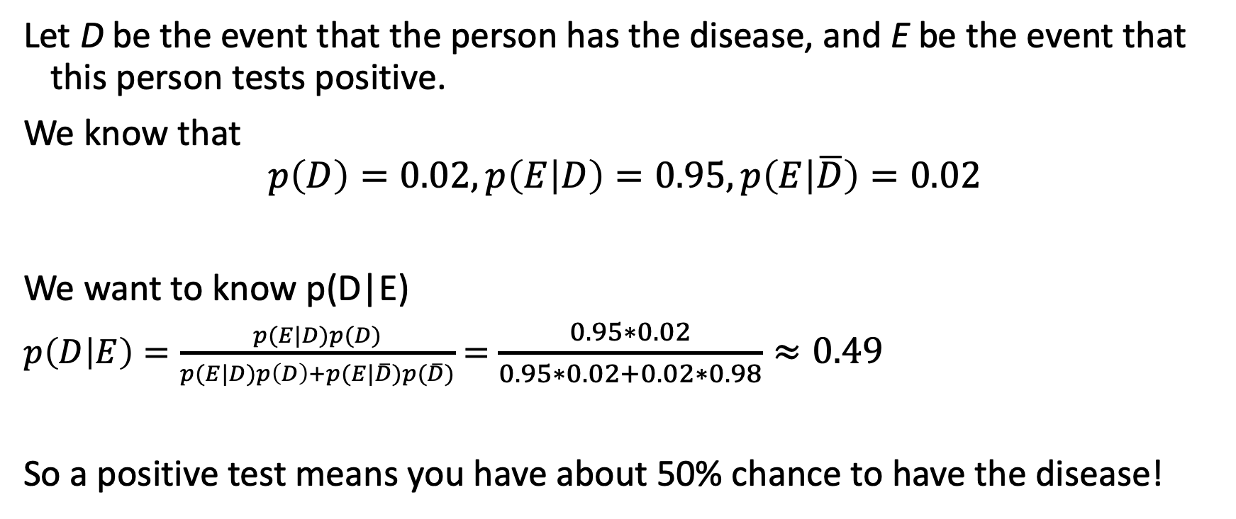
Example
Let D be the event that the person has the disease, and E be the event that this person tests positive.
We know that
$$p\left(D\right)=0.02, p\left(E | D\right)=0.95,p\left(E | \overline{D}\right)=0.02$$
We want to know p(D|E)
$p\left(D | E\right)=\frac{p(E|D)p(D)}{p(E|D)p\left(D\right)+p(E|\overline{D})p(\overline{D})}=$ $\frac{0.95∗0.02}{0.95∗0.02+0.02∗0.98}≈0.49$
So a positive test means you have about 50% chance to have the disease!

Slide 56
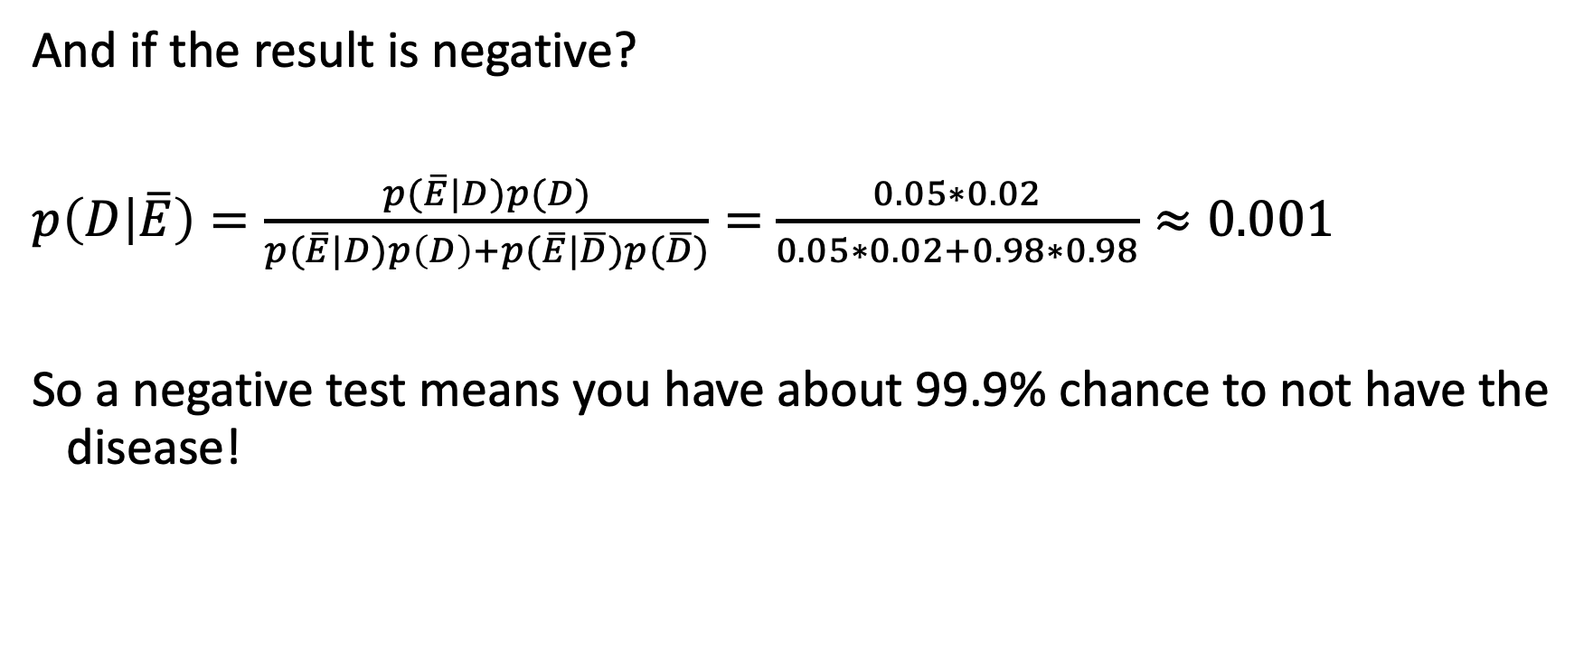
Example
And if the result is negative?
$p\left(D | \overline{E}\right)=\frac{p(\overline{E}|D)p(D)}{p(\overline{E}|D)p\left(D\right)+p(\overline{E}|\overline{D})p(\overline{D})}=$ $\frac{0.05∗0.02}{0.05∗0.02+0.98∗0.98}≈0.001$
So a negative test means you have about 99.9% chance to not have the disease!

Slide 57
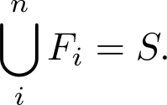
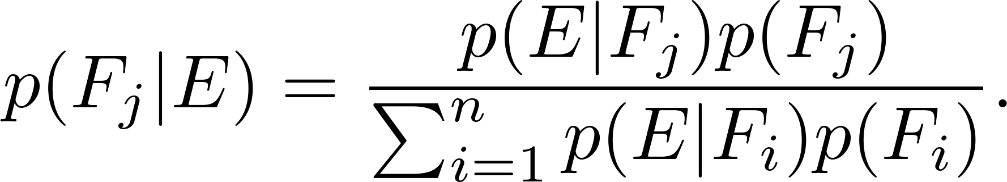
Generalized Bayes’ Theorem
Generalized Bayes’ Theorem: Suppose that E is an event from a sample space S and that F₁, F₂, …, F_{n} are mutually exclusive events such that
Assume that p(E) ≠ 0 for i = 1, 2, …, n. Then

Slide 58
Summary
Bayes’ Theorem
Testing diseases
Generalized Bayes’ Theorem

